Slide 1

Game Profile
I’m Hero soldier
I’m your Enemy!

Slide 2
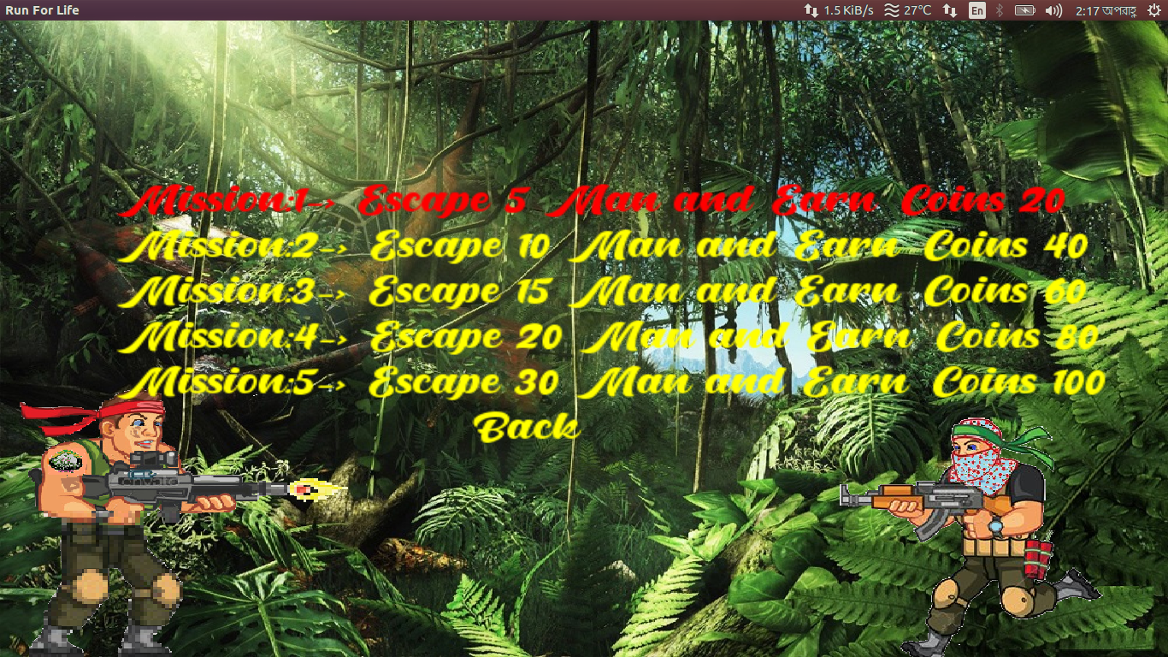
Challenges

Slide 3
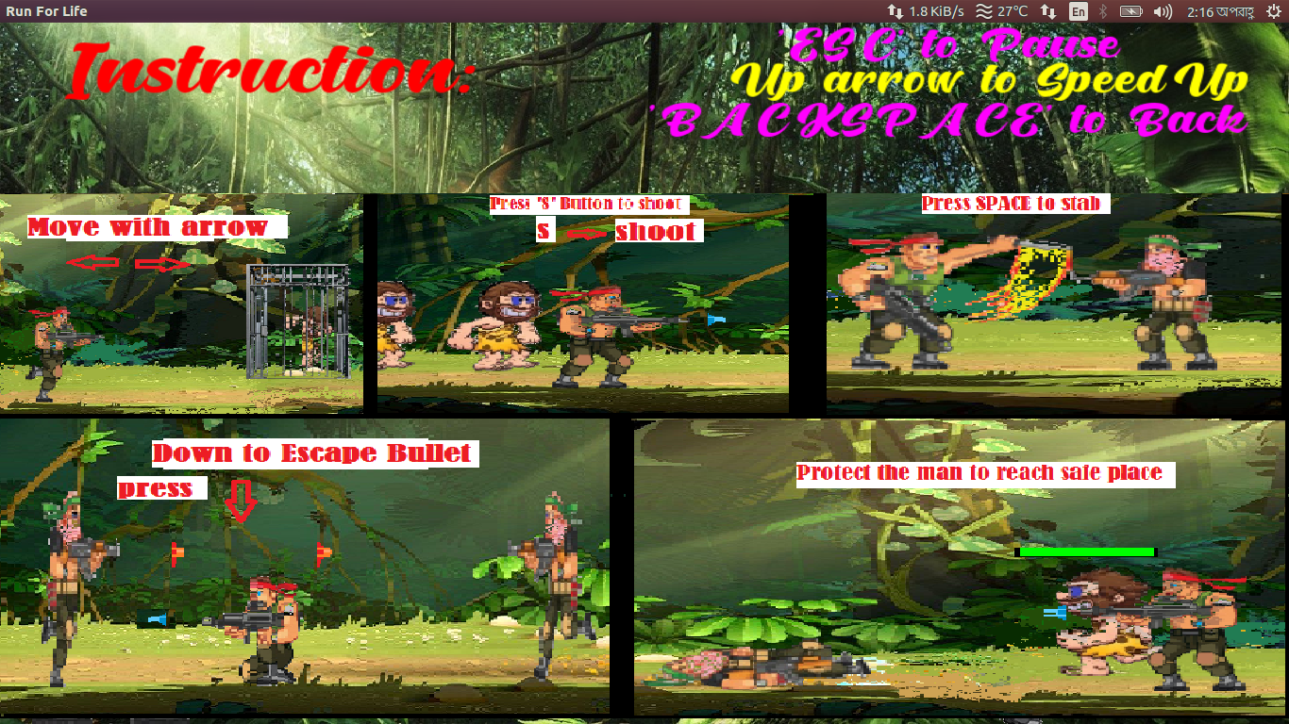
Instructions

Slide 4
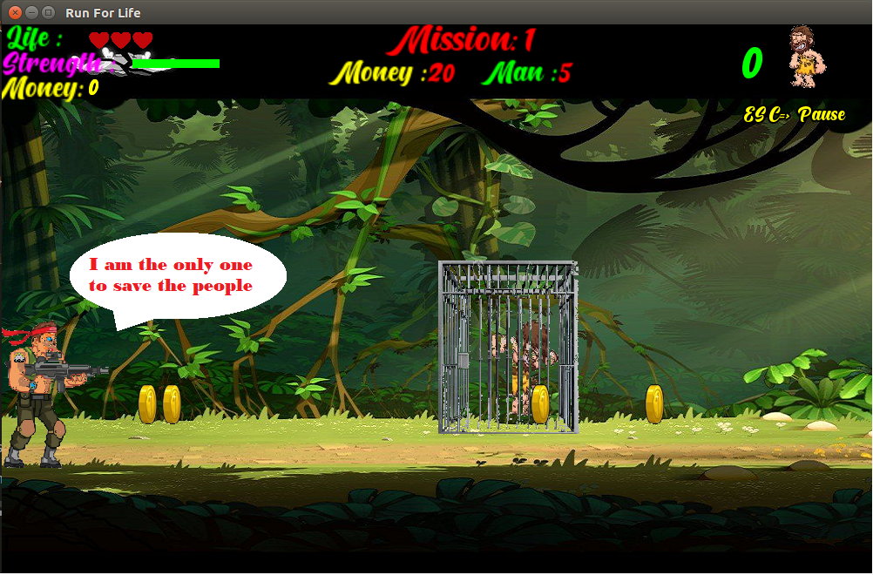
Game Story
Who will save the forest!

Slide 5
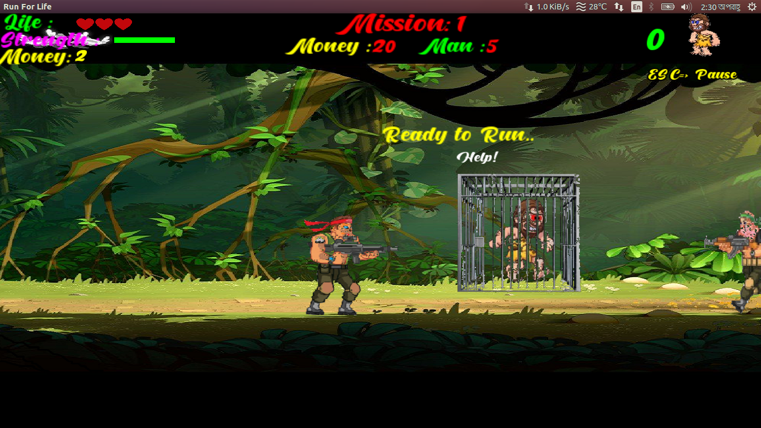
Game Story
I’m here
I’m also here

Slide 6
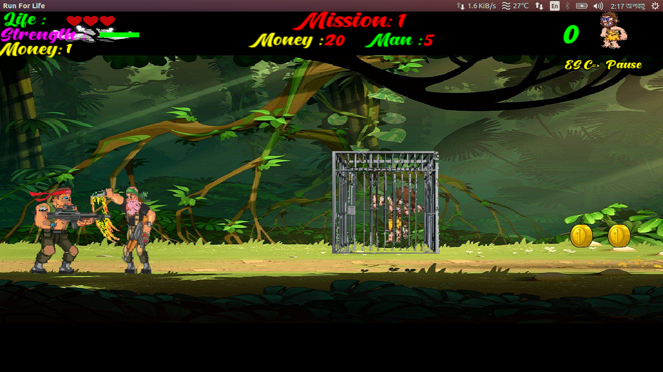
Game Story
Help me!
You can’t

Slide 7
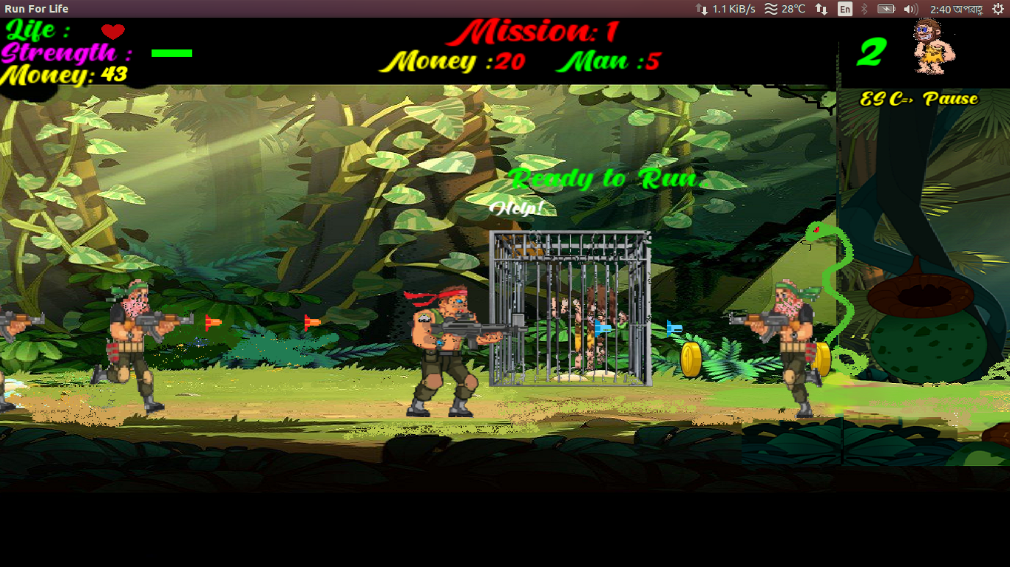
Game Story
Boo bo…

Slide 8
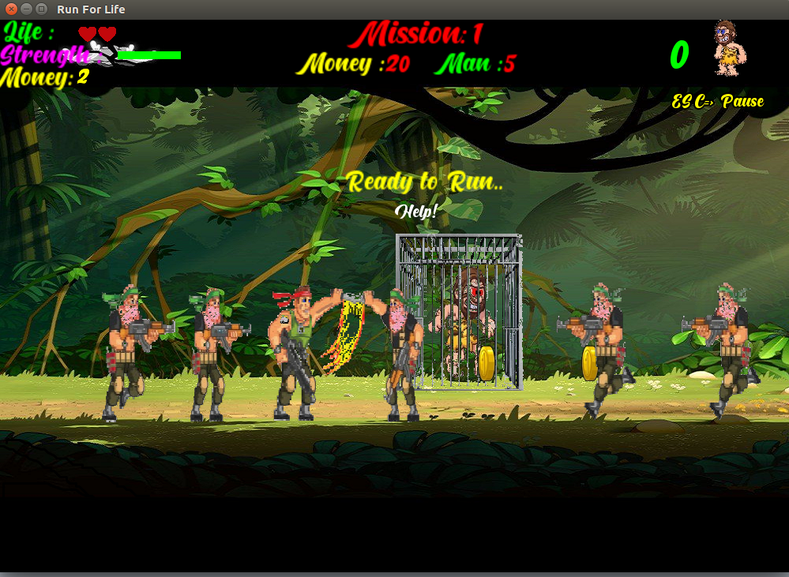
Game Story
Go fast
Get him

Slide 9
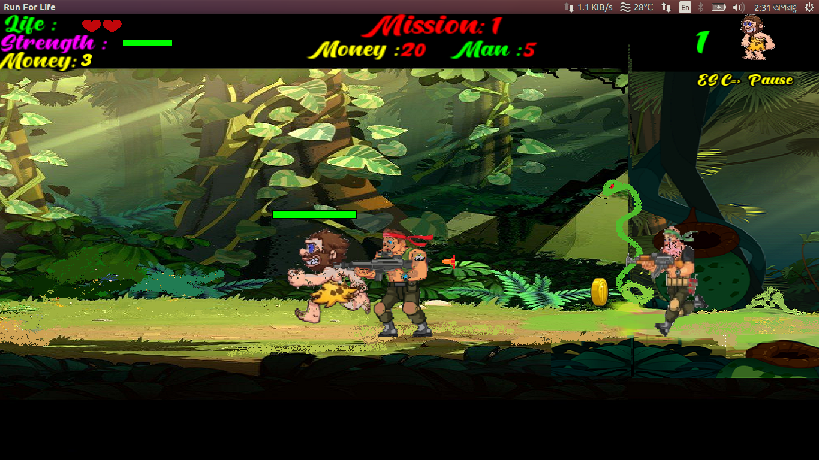
Game Story
Hiss..
Run..
Safe Zone

Slide 10
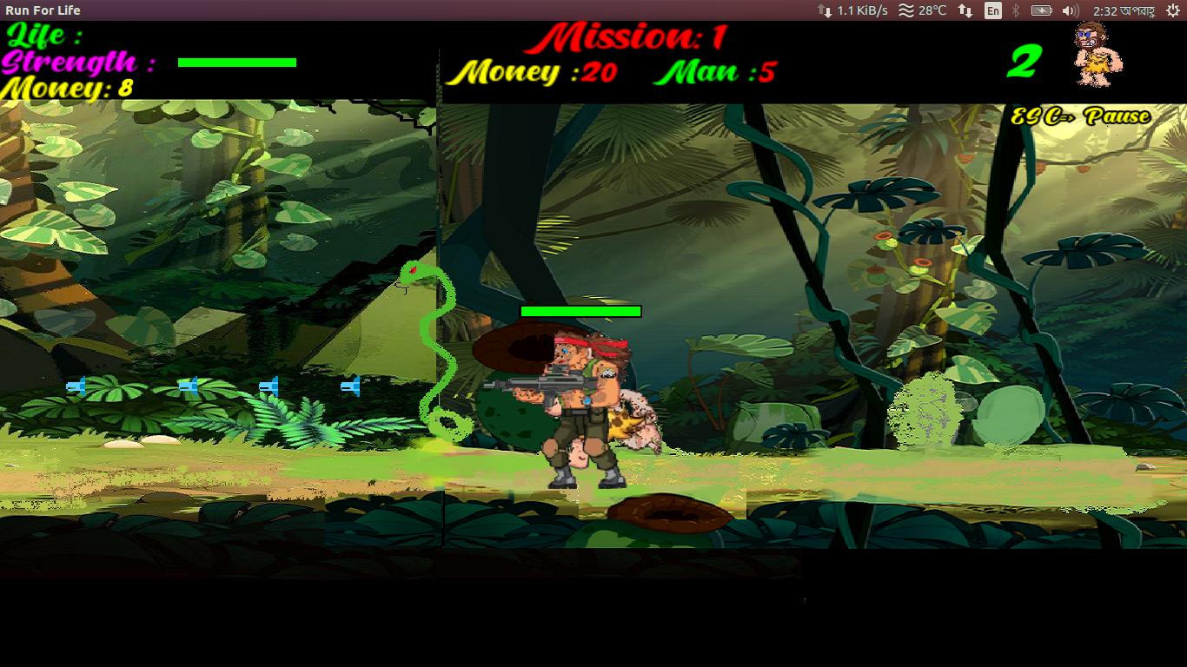
Game Story
My life is limited

Slide 11
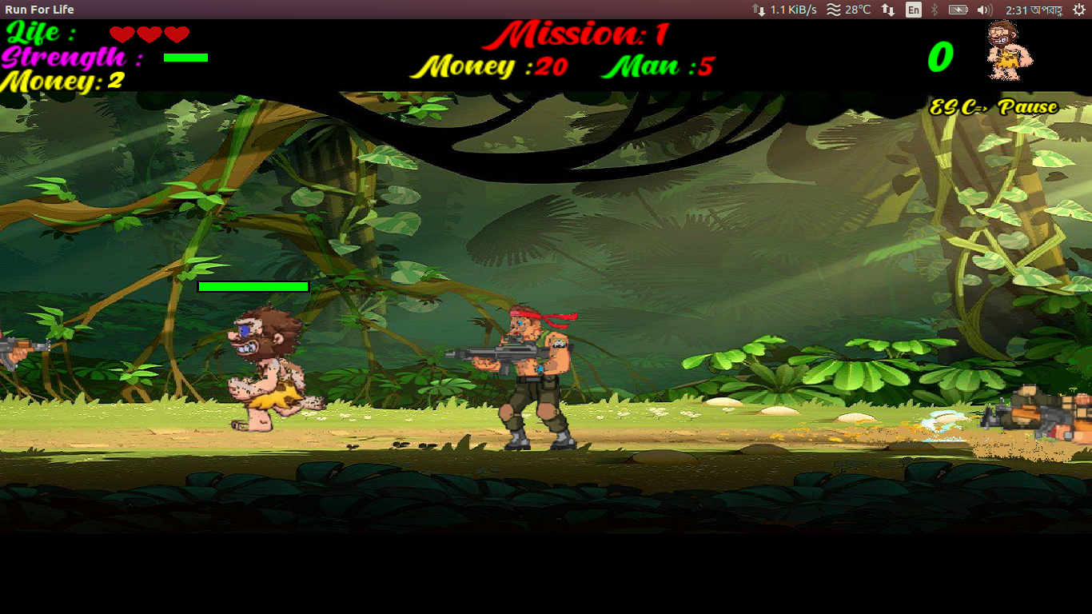
Game Story
Let me go
Don’t go alone

Slide 12
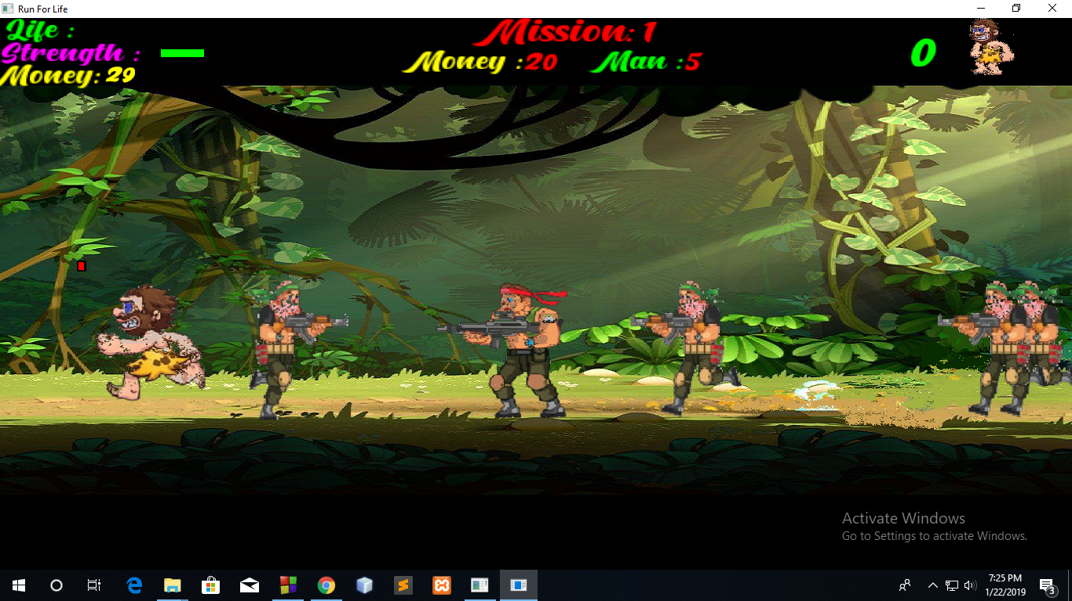
Game Story
Dead
Life
Oh no
Fire him

Slide 13
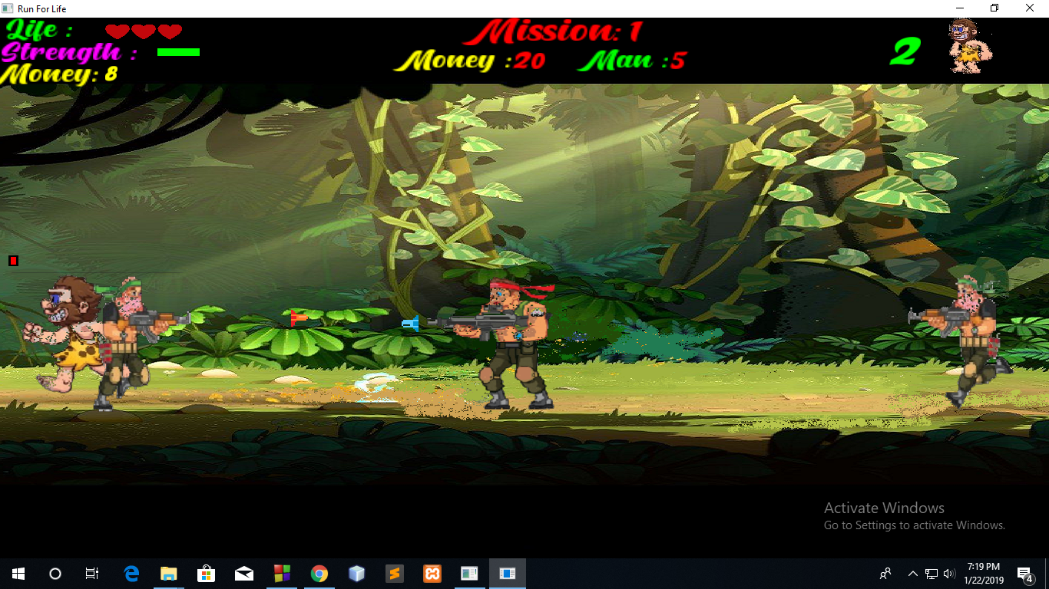
Game Story
Hee..
you can’t
I won’t spare you

Slide 14
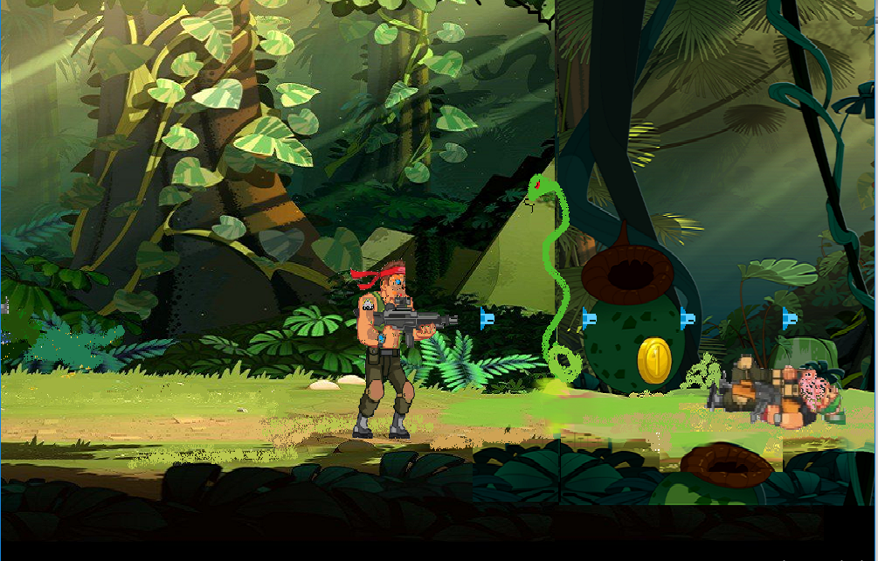
Game Story
I will save them
I ill save
them
No..

Slide 15
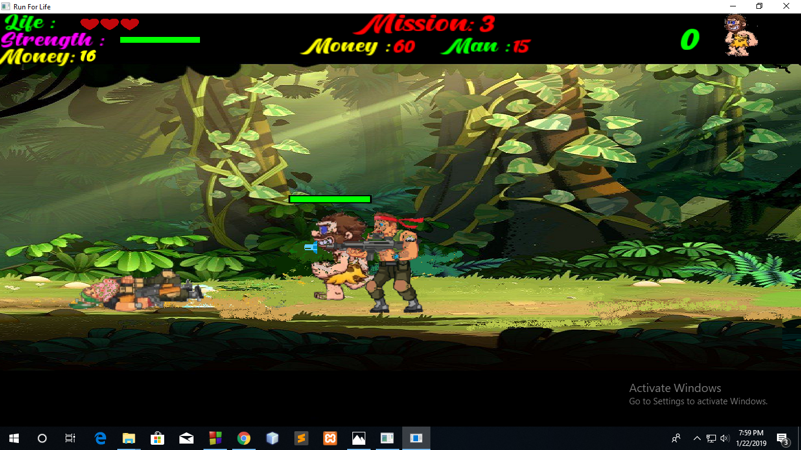
Game Story
Go fast

Slide 16
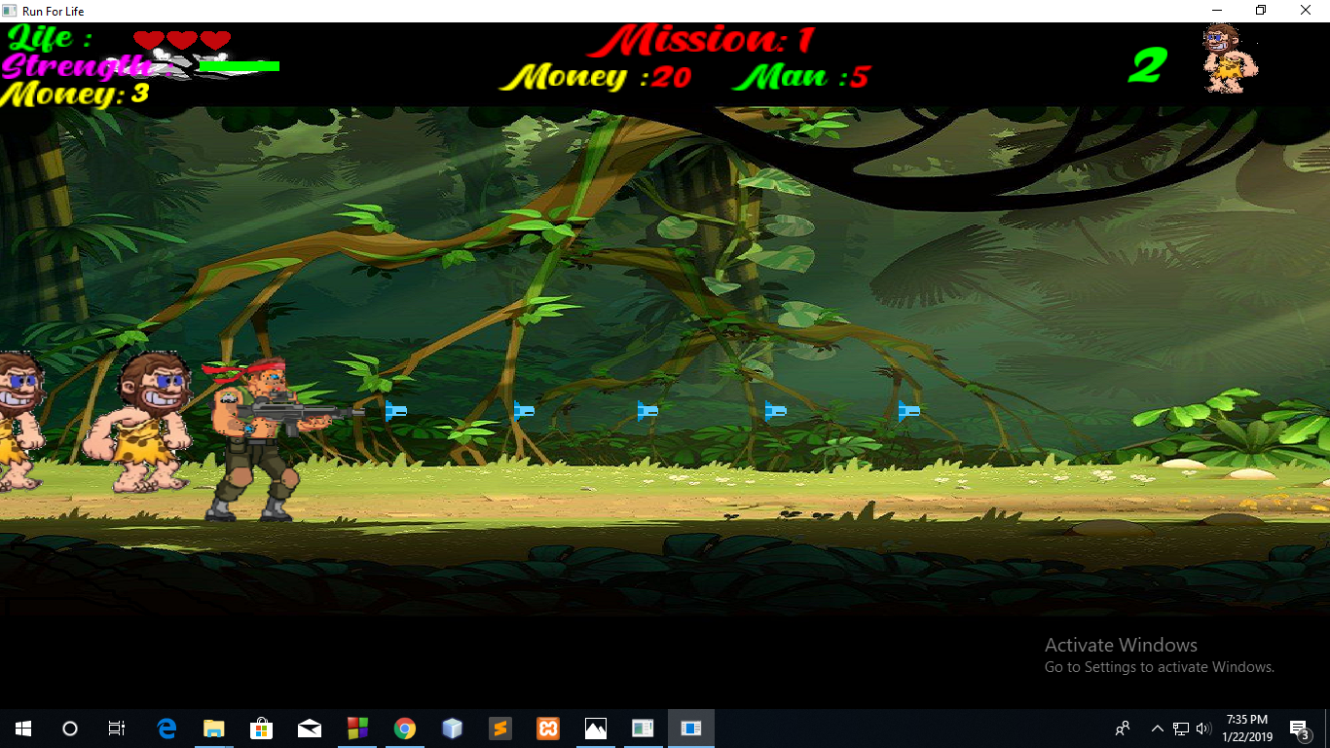
Game Story
You are safe here

Slide 17
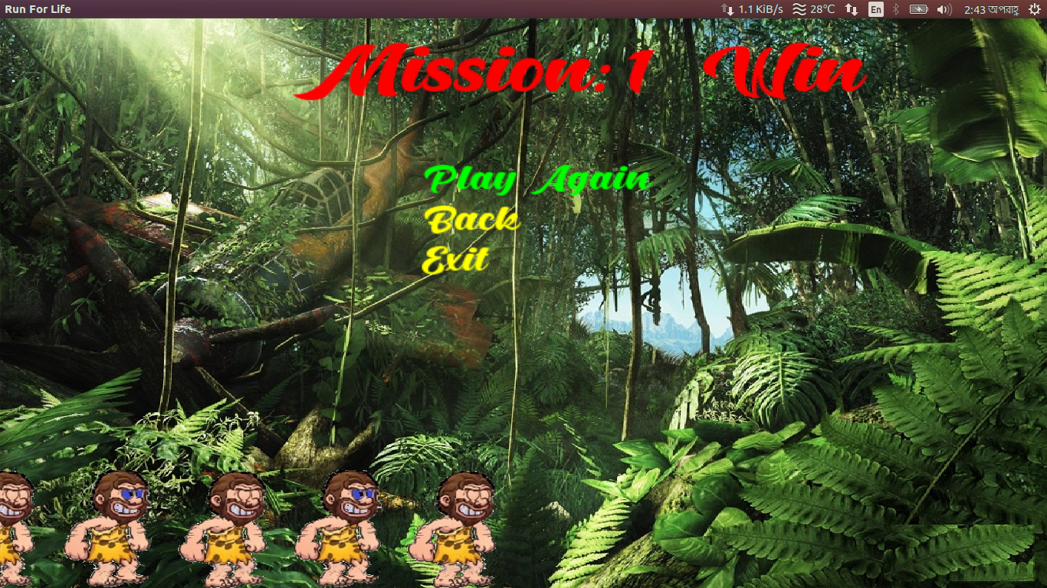
Game Story

